Slide 1
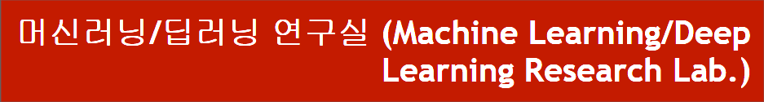
DARTS research progress
Department of Computer Engineering
Dongseo University
Jie Yong Shin,
Dae-Ki Kang, Prof (advisor)
2022.08.23
Notes:
1

Slide 2
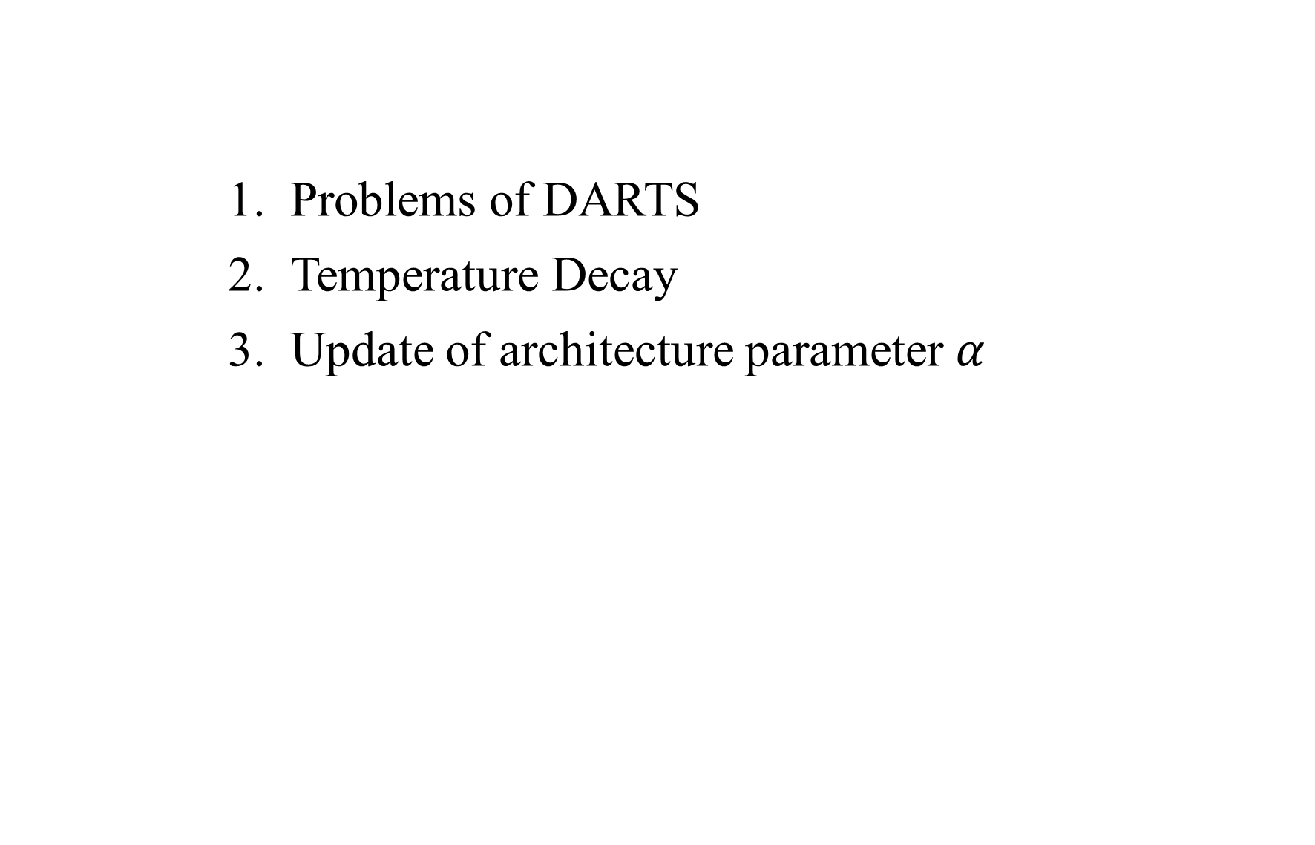
CONTENTS
Problems of DARTS
Temperature Decay
Update of architecture parameter $α$
Notes:
2

Slide 3
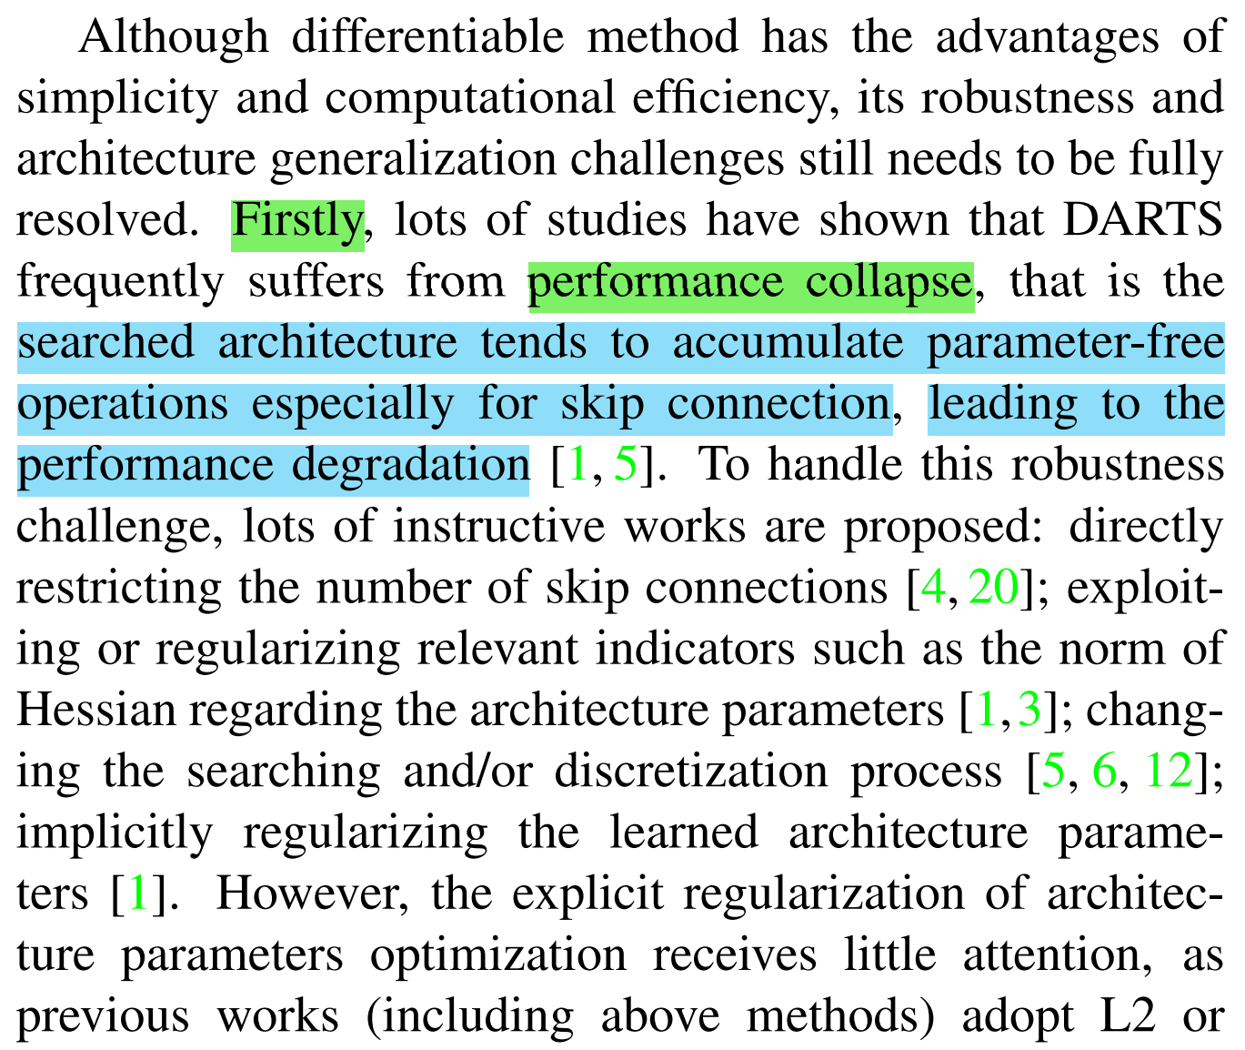
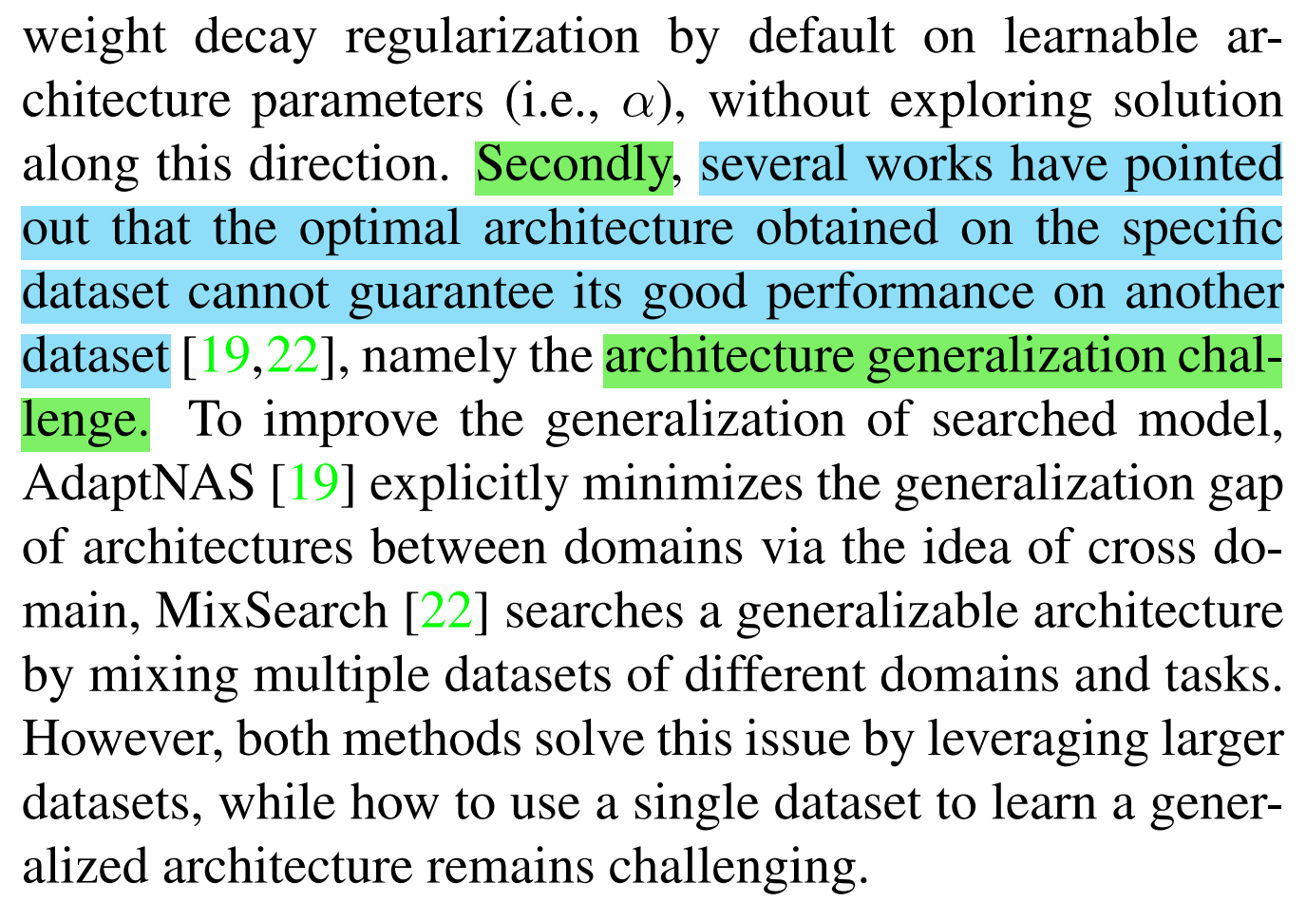
1. Problems of DARTS
Problems
Performance Collapse : Searched architecture tends to select skip connection.
Architecture Generalization Challenge : Architecture searched in specific dataset cannot guarantee it is good also on another dataset.
Notes:
3

Slide 4
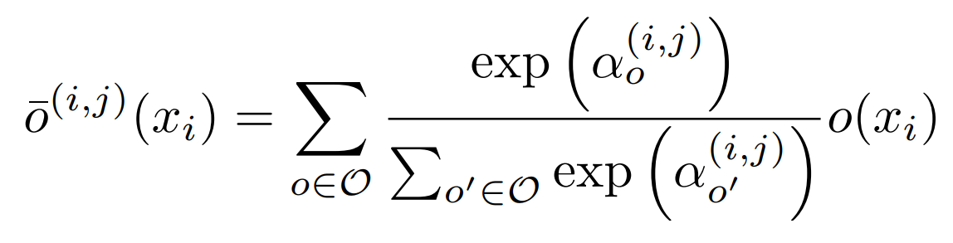
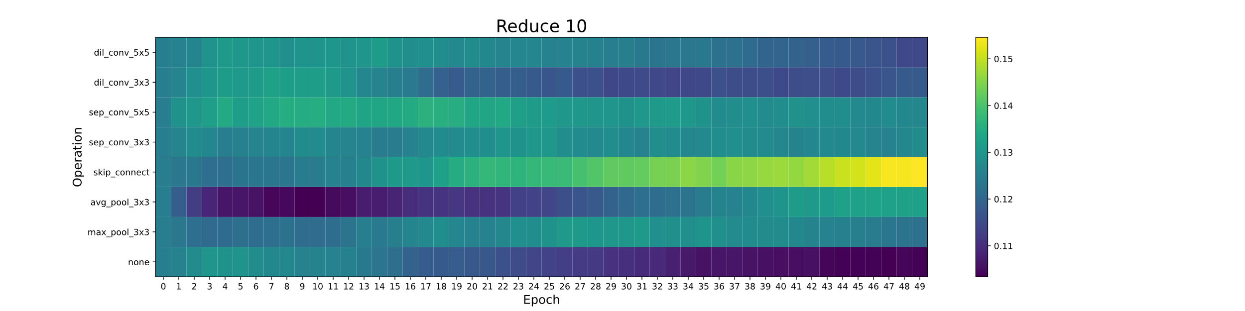
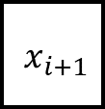
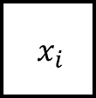
1. Problems of DARTS
$${ x}_{i}$$
$${ x}_{i+1}$$
Assumption
- Skip connection become dominant because of its linearity
Idea
Temperature annealing with decay. (exploration/exploitation)
Decrease the number of competitor. (to make it non-linear)
Notes:
4

Slide 5
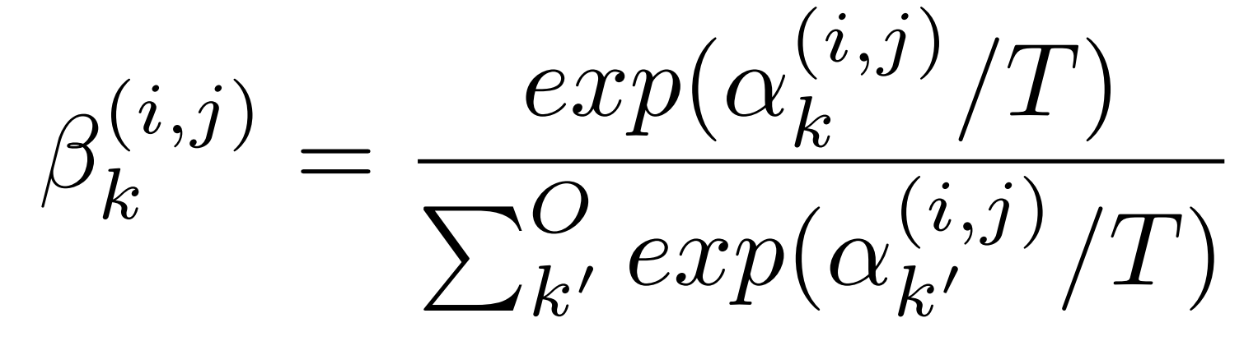
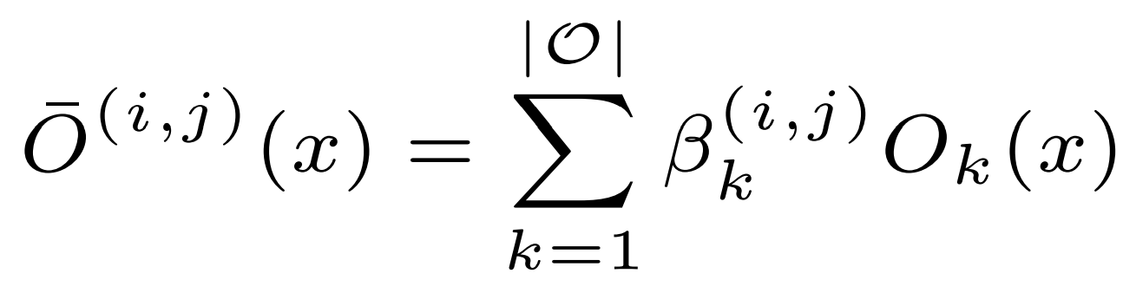
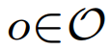
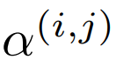
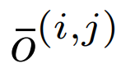
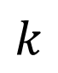
2. Temperature Decay
Operation pool = [Convolution,
Pooling,
Skip,
Dilation]
$${ x}_{i}$$
$${ x}_{i+1}$$
$$k$$
: Example of a set O : {Convolution, Pooling, Skip, Dilation}
: Weights of operations (Vector)
: Mixed operation
Notes:
5

Slide 6
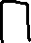
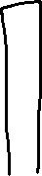
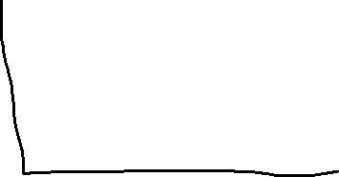
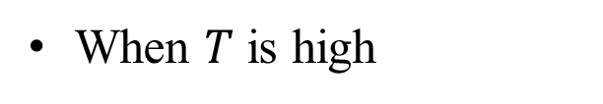
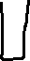
2. Temperature Decay
When $T$ is high
High exploration, Low exploitation
Notes:
6

Slide 7
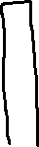
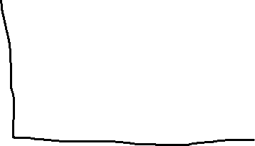
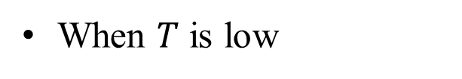
2. Temperature Decay
When $T$ is low
High exploitation, Low exploration
Notes:
7

Slide 8
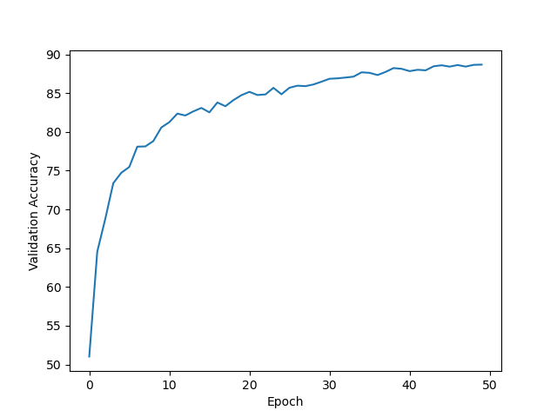
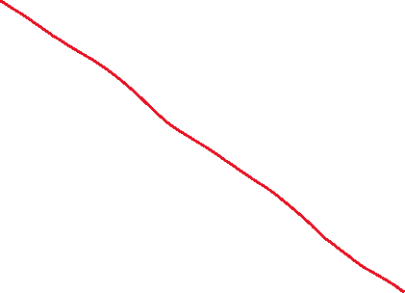
2. Temperature Decay
Notes:
8

Slide 9
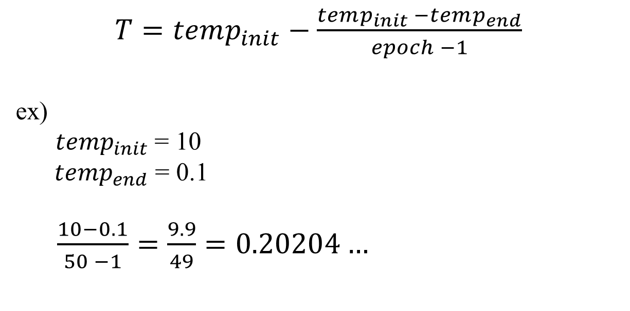
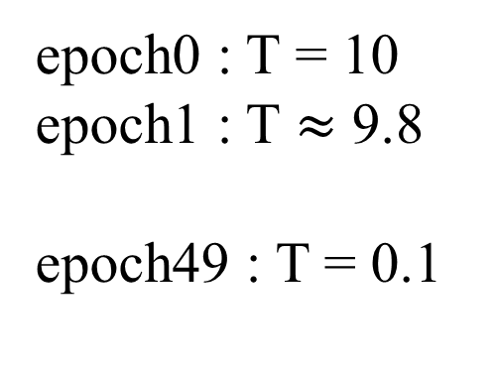
2. Temperature Decay
$T=temp_{init}−\frac{temp_{init} −temp_{end}}{epoch −1}$
ex)
$temp_{init}$= 10
$temp_{end}$ = 0.1
$\frac{10−0.1}{50 −1}=\frac{9.9}{49}=0.20204…$
epoch0 : T = 10
epoch1 : T $≈$ 9.8
epoch49 : T = 0.1
Notes:
9

Slide 10
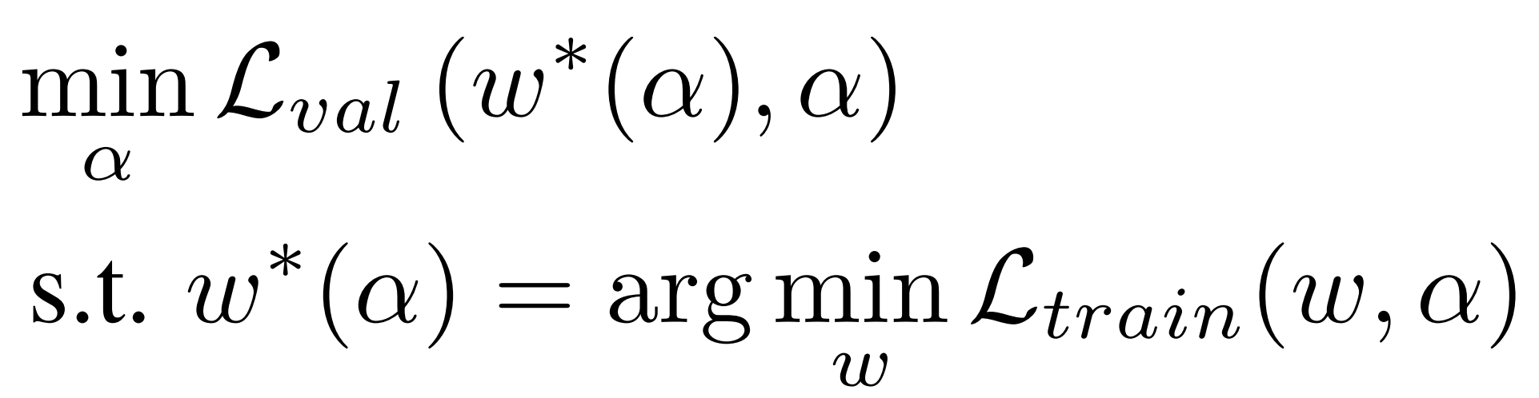
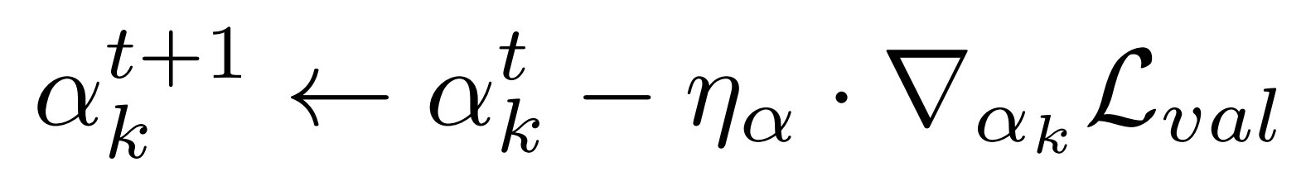
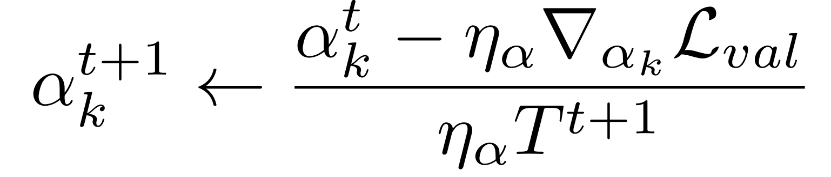
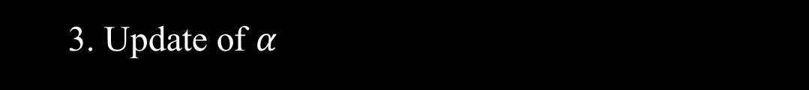
3. Update of $α$
Optimization function of DARTS
How the alpha updated
$k$ : number of operations in set $O$
Temperature Annealing
Notes:
10

Slide 11
References
DARTS: Differentiable Architecture Search https://arxiv.org/abs/1806.09055
Differentiable Architecture Search with Ensemble Gumbel-Softmax https://arxiv.org/abs/1905.01786
Categorical Reparameterization with Gumbel-Softmax https://arxiv.org/abs/1611.01144
Fair DARTS: Eliminating Unfair Advantages in Differentiable Architecture Search https://arxiv.org/abs/1911.12126
β-DARTS: Beta-Decay Regularization for Differentiable Architecture Search https://arxiv.org/abs/2203.01665
Notes:
11

Slide 12
Thank you
Q & A
12
Notes:
-
The training of procedure for is to maximize the probability of D making a mistake. This framework corresponds to a minimax two-player game.
In the space of arbitrary functions G and D, a unique solution exists, with G recovering the training data distribution and D equal to ½ everywhere.
12

Slide 13
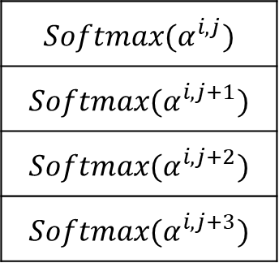
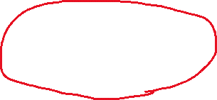
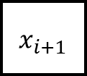
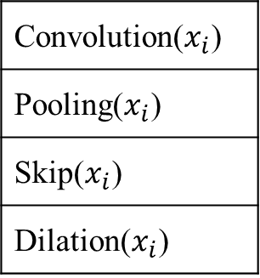
1. DARTS
$${ x}_{i}$$
$${ x}_{i+1}$$
$${Softmax(α}^{i,j})$$
$${Softmax(α}^{i,j+1})$$
$${Softmax(α}^{i,j+2})$$
$${Softmax(α}^{i,j+3})$$
x
Convolution($x_{i}$)
Pooling($x_{i}$)
Skip($x_{i}$)
Dilation($x_{i}$)
x
+
$${ x}_{i+1}$$
x
x
$β$ · Convolution($x_{i}$) + $β$· Pooling($x_{i}$) + $β$· Skip($x_{i}$) + $β$· Dilation($x_{i}$) = out
Notes:
13

Slide 14
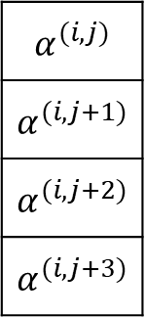
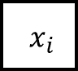
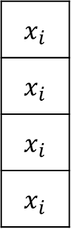
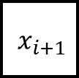
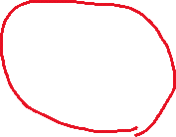
1. DARTS
$${ x}_{i}$$
$${ x}_{i+1}$$
$${ x}_{i}$$
$$α^{(i,j)}$$
$$α^{(i,j+1)}$$
$$α^{(i,j+2)}$$
$$α^{(i,j+3)}$$
x
Convolution()
Pooling()
Skip()
Dilation()
$$x_{i}$$
$$x_{i}$$
$$x_{i}$$
$$x_{i}$$
x
+
$${ x}_{i+1}$$
x
x
$α$ * convolution($x_{i}$) + $α$ * pooling($x_{i}$) + $α$ * skip($x_{i}$) + $α$ * dilation($x_{i}$) = out
Notes:
14

Slide 15

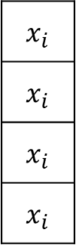
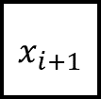
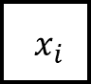
1. DARTS
$${ x}_{i}$$
$${ x}_{i+1}$$
$$x_{i}$$
$$x_{i}$$
$$x_{i}$$
$$x_{i}$$
Convolution()
Pooling()
Skip()
Dilation()
$${ x}_{i}$$
+
$${ x}_{i+1}$$
convolution($x_{i}$) + pooling($x_{i}$) + skip($x_{i}$) + dilation($x_{i}$) = out
Notes:
15

Slide 16
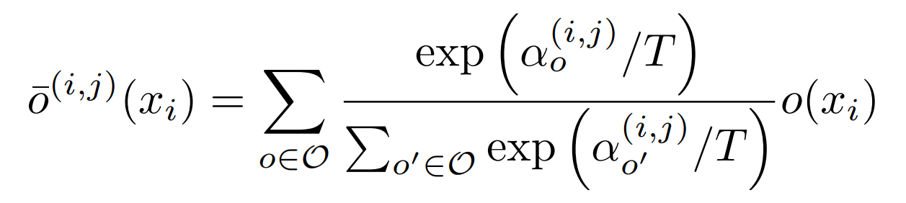
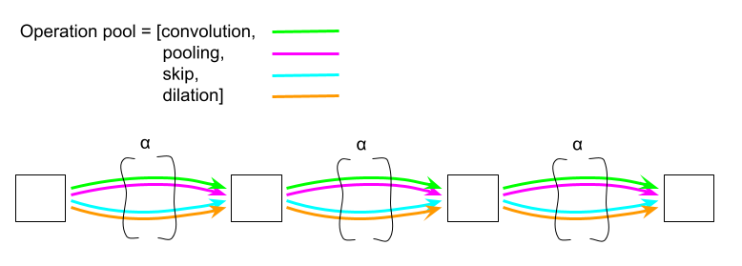
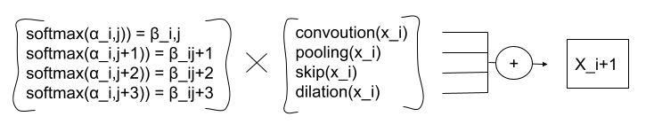
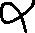
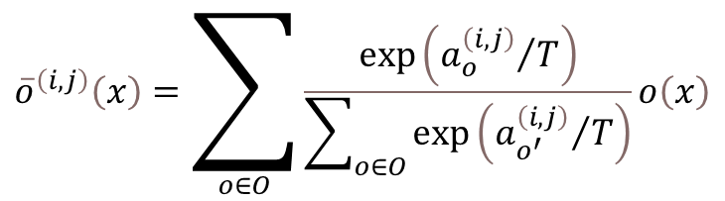
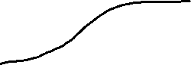
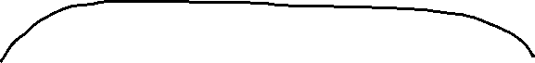
3. Idea
Mixed operation with Temperature Anealing
$${\overline{o}}^{\left(i,j\right)}\left(x\right)=\sum_{o∈O}{\frac{\exp\left({a_{o}^{\left(i,j\right)}}/T\right)}{\sum_{o∈O}{\exp\left({a_{o^{′}}^{\left(i,j\right)}}/T\right)}}o\left(x\right)}$$
Notes:
16

Slide 17
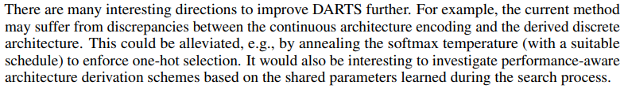

5. Research Progress
Notes:
17

Slide 18

3. Code Analysis
train_search.py
Notes:
18

Slide 19

3. Code Analysis
train_search.py
Notes:
19

Slide 20

3. Code Analysis
train_search.py
Notes:
20

Slide 21

3. Code Analysis
train.py
Notes:
21

Slide 22

3. Code Analysis
test.py
Notes:
22

Slide 23

3. Code Analysis
Genotype
Notes:
23

Slide 24

3. Code Analysis
Operators
Notes:
24

Slide 25


3. Code Analysis
Notes:
25

Slide 26

3. Code Analysis
Notes:
26

Slide 27


4. Problems Discussed
Common case)
After 50th epoch
After 50th epoch
Notes:
27

Slide 28

6. Conclusion and Discussion
이러한 결과는 기존의 Neural Architecture Search 문제를 제기하고 해결한
NAS, ENAS등의 유명 논문들이 채용한 문제 세팅을 DARTS에서도 그대로 채용하였기 때문에 softmax만으로는 충분한 continuous relaxation을 이끌어내지 못했기 때문이라고 생각함. 8가지 operation이 아닌, 10만개 정도의 operation이 있다면 어느정도 충분한 relaxation이 가능할 것으로 예상되나, 이는 목적에 맞지 않는 불필요하게 너무 많은 operation일 수 있다.
Notes:
28

Slide 29



1. Summary
Approximation that significantly reduces search cost
Notes:
29

Slide 30

1. Summary
As a result, it outperforms other SOTA algorithms
Notes:
30

Slide 31

2. Search space
Directed Acyclic Graph
Notes:
31

Slide 32



2. Search space
Directed Acyclic Graph
x(i) : input
x(j) : output
o(i,j) : operation (transforms x(i))
Notes:
32

Slide 33



3. Continuous relaxation and optimization
The task of architecture search then reduces to learning a set of continuous variables α = { α (i,j) }
At the end of the search, replace
with
Notes:
33

Slide 34

4. Results
The example shows that a suitable choice of ξ helps to converge to a better local optimum.
Notes:
34

Slide 35



4. Conclusion and Discussion
Notes:
35

Slide 36


3. Continuous relaxation and optimization
Algorithm
: Learning rate for a step of inner optimization
Notes:
36

Slide 37
5. Conclusion
Optimization gap
discrepancies between the continuous architecture encoding and the derived discrete architecture.
This could be alleviated by annealing the softmax temperature (with a suitable schedule) to enforce one-hot selection.
Performance-aware architecture derivation schemes based on the shared parameters learned during the search process.
Notes:
37

Slide 38

4. Results
Transfer learning with DARTS
Notes:
38

Slide 39

4. Results
Gumbel-Softmax
Notes:
39

Slide 40

4. Results
Gumbel-Softmax
Notes:
40

Slide 41






3. Related Work
Mixed operation with Temperature Annealing
$$α_{k^{′}}$$
0.48
0.17
0.07
0.28
x
Convolution($x_{i}$)
Pooling($x_{i}$)
Skip($x_{i}$)
Dilation($x_{i}$)
x
+
$${ x}_{i+1}$$
$$L_{val}(L_{train}\left(w^{∗}\right), α)$$
x
x
Notes:
41

Slide 42
1. Continuous Relaxation
Notes:
42

Slide 43

3. Related Work
Mixed operation with Temperature Annealing
$$α_{o^{′}}$$
0.48
0.17
0.07
0.28
x
Convolution($x_{i}$)
Pooling($x_{i}$)
Skip($x_{i}$)
Dilation($x_{i}$)
x
+
$${ x}_{i+1}$$
$$L_{val}(L_{train}\left(w^{∗}\right), α)$$
x
x
Notes:
43

Slide 44



4. Idea (1/2)
Decaying Temperature
First, more exploration with high temperature.
0.24
0.26
0.23
0.28
x
Convolution($x_{i}$)
Pooling($x_{i}$)
Skip($x_{i}$)
Dilation($x_{i}$)
x
+
$${ x}_{i+1}$$
x
x
Notes:
44

Slide 45
4. Idea (1/2)
Decaying Temperature
After then, more exploitation with low temperature.
0.1
0.1
0.1
0.7
x
Convolution($x_{i}$)
Pooling($x_{i}$)
Skip($x_{i}$)
Dilation($x_{i}$)
x
+
$${ x}_{i+1}$$
x
x
Notes:
45

Slide 46


2. Discussion
Notes:
46

Slide 47



1. Continuous Relaxation
: Example of a set O : {Convolution, Pooling, Skip, Dilation}
: Weights of operations (Vector)
: Mixed operation
Notes:
47

Slide 48









1. Continuous Relaxation
Operation pool = [Convolution,
Pooling,
Skip,
Dilation]
$${ x}_{i}$$
$${ x}_{i+1}$$
$${ x}_{i+2}$$
$${ x}_{i+3}$$
$$Softmax\left(α\right)=β$$
$${= x}_{i+1}$$
$i$ : $i$ th edge
$j$ : $j$ th operation in $i$ th edge
Notes:
48

Slide 49



1. Continuous Relaxation
$${ x}_{i}$$
$${ x}_{i+1}$$
$${ x}_{i}$$
Convolution()
Pooling()
Skip()
Dilation()
$$x_{i}$$
$$x_{i}$$
$$x_{i}$$
$$x_{i}$$
+
$${ x}_{i+1}$$
Convolution($x_{i}$) + Pooling($x_{i}$) + Skip($x_{i}$) + Dilation($x_{i}$) = out
Notes:
49

Slide 50



1. Continuous Relaxation
$${ x}_{i}$$
$${ x}_{i+1}$$
Convolution($x_{i}$)
Pooling($x_{i}$)
Skip($x_{i}$)
Dilation($x_{i}$)
+
$${ x}_{i+1}$$
Convolution($x_{i}$) + Pooling($x_{i}$) + Skip($x_{i}$) + Dilation($x_{i}$) = out
Notes:
50

Slide 51




1. Continuous Relaxation
$${ x}_{i}$$
$${ x}_{i+1}$$
$$α^{(i,j)}$$
$$α^{(i,j+1)}$$
$$α^{(i,j+2)}$$
$$α^{(i,j+3)}$$
x
Convolution($x_{i}$)
Pooling($x_{i}$)
Skip($x_{i}$)
Dilation($x_{i}$)
x
+
$${ x}_{i+1}$$
x
x
$α$ · Convolution($x_{i}$) + $α$ · Pooling($x_{i}$) + $α$ · Skip($x_{i}$) + $α$ · Dilation($x_{i}$) = out
Notes:
51

Slide 52





1. Continuous Relaxation
$${ x}_{i}$$
$${ x}_{i+1}$$
$$α^{(i,j)}$$
$$α^{(i,j+1)}$$
$$α^{(i,j+2)}$$
$$α^{(i,j+3)}$$
x
Convolution($x_{i}$)
Pooling($x_{i}$)
Skip($x_{i}$)
Dilation($x_{i}$)
x
$$Softmax( )$$
+
$${ x}_{i+1}$$
x
x
$α$ · Convolution($x_{i}$) + $α$ · Pooling($x_{i}$) + $α$ · Skip($x_{i}$) + $α$ · Dilation($x_{i}$) = out
Notes:
52

Slide 53




1. Continuous Relaxation
$${ x}_{i}$$
$${ x}_{i+1}$$
$$β_{conv}$$
$$β_{pool}$$
$$β_{skip}$$
$$β_{dil}$$
x
Convolution($x_{i}$)
Pooling($x_{i}$)
Skip($x_{i}$)
Dilation($x_{i}$)
x
+
$${ x}_{i+1}$$
x
x
$β$ · Convolution($x_{i}$) + $β$· Pooling($x_{i}$) + $β$· Skip($x_{i}$) + $β$· Dilation($x_{i}$) = out
Notes:
53

Slide 54



1. Continuous Relaxation
$${ x}_{i}$$
$${ x}_{i+1}$$
$$α^{(i,j)}$$
$$α^{(i,j+1)}$$
$$α^{(i,j+2)}$$
$$α^{(i,j+3)}$$
$$Softmax( )$$
Notes:
54

Slide 55


1. Continuous Relaxation
$${ x}_{i}$$
$${ x}_{i+1}$$
$$α_{conv}$$
$$α_{pool}$$
$$α_{skip}$$
$$α_{dil}$$
$$Softmax( )$$
Notes:
55

Slide 56




1. Continuous Relaxation
$${ x}_{i}$$
$${ x}_{i+1}$$
$$α$$
$$β$$
2
1
0.1
1.5
0.47
0.17
0.07
0.28
$$Softmax( )$$
Notes:
56

Slide 57



1. Continuous Relaxation
$${ x}_{i}$$
$${ x}_{i+1}$$
0.47
0.17
0.07
0.28
x
Convolution($x_{i}$)
Pooling($x_{i}$)
Skip($x_{i}$)
Dilation($x_{i}$)
x
+
$${ x}_{i+1}$$
x
x
Notes:
57

Slide 58












1. Continuous Relaxation
Back-propagation
$${ x}_{i}$$
$${ x}_{i+1}$$
$${ x}_{i+2}$$
$${ x}_{i+3}$$
$$L_{val}(L_{train}\left(w^{∗}\right), α)$$
Notes:
58

Slide 59



1. Continuous Relaxation
$${ x}_{i}$$
$${ x}_{i+1}$$
0.48
0.17
0.07
0.28
x
Convolution($x_{i}$)
Pooling($x_{i}$)
Skip($x_{i}$)
Dilation($x_{i}$)
x
+
$${ x}_{i+1}$$
$$L_{val}(L_{train}\left(w^{∗}\right), α)$$
x
x
Notes:
59

Slide 60


1. Continuous Relaxation
$${ x}_{i}$$
$${ x}_{i+1}$$
Search end
0.1
0.2
0.4
0.3
x
Convolution($x_{i}$)
Pooling($x_{i}$)
Skip($x_{i}$)
Dilation($x_{i}$)
x
+
$${ x}_{i+1}$$
x
x
Notes:
60

Slide 61

1. Continuous Relaxation
$${ x}_{i}$$
$${ x}_{i+1}$$
One-hot encoding
0
0
1
0
x
Convolution($x_{i}$)
Pooling($x_{i}$)
Skip($x_{i}$)
Dilation($x_{i}$)
x
+
$${ x}_{i+1}$$
x
x
Notes:
61

Slide 62


1. Continuous Relaxation
$${ x}_{i}$$
$${ x}_{i+1}$$
Skip($x_{i}$)
$${ x}_{i+1}$$
Notes:
62

Slide 63




3. Related Work
DARTS’s Mixed operation
Gumbel-Softmax DARTS
Fair DARTS
Notes:
63

Slide 64
1. Continuous Relaxation
: Example of a set O : {Convolution, Pooling, Skip, Dilation}
: Weights of operations (Vector)
: Mixed operation
Notes:
64

Slide 65






4. Idea (2/2)
1 ~ 100 epoch
0.25
0.25
0.25
0.25
x
Convolution($x_{i}$)
Pooling($x_{i}$)
Skip($x_{i}$)
Dilation($x_{i}$)
x
+
$${ x}_{i+1}$$
$$L_{val}(L_{train}\left(w^{∗}\right), α)$$
x
x
After 100 epoch
0.2
0
0.4
0
x
Convolution($x_{i}$)
Pooling($x_{i}$)
Skip($x_{i}$)
Dilation($x_{i}$)
x
+
$${ x}_{i+1}$$
$$L_{val}(L_{train}\left(w^{∗}\right), α)$$
x
x
Notes:
65

Slide 66






4. Idea (2/2)
101 ~ 200 epoch
0.5
0.5
x
Skip($x_{i}$)
Convolution($x_{i}$)
+
$${ x}_{i+1}$$
$$L_{val}(L_{train}\left(w^{∗}\right), α)$$
x
Search end
0.1
0.9
x
Skip($x_{i}$)
Convolution($x_{i}$)
+
$${ x}_{i+1}$$
$$L_{val}(L_{train}\left(w^{∗}\right), α)$$
x
Notes:
66

